Slide 1



HR ANALYTICS
EMPLOYEE ATTRITION
Team 13
KEERTHI ANAND
SUBBAIAH VEERAMANI

Slide 2
BUSINESS PROBLEM
Employees are the backbone of the organization. Organization's performance is heavily based on the quality of the employees.
Challenges that an organization has to face due employee attrition are:
01
02
Expensive in terms of both money and time to train new employees.
Loss of experienced employees
03
04
Impact in productivity
Impact profit

Slide 3

BUSINESS QUESTIONS
Having clarity on questions is very crucial because the solution that is being developed will make sense only if we have well stated problem.
01
WHAT FACTORS ARE CONTRIBUTING MORE TO EMPLOYEE ATTRITION?
02
WHAT TYPE OF MEASURES SHOULD THE COMPANY TAKE IN ORDER TO RETAIN THEIR EMPLOYEES?
03
WHAT BUSINESS VALUE DOES THE MODEL BRING?
04
WHICH BUSINESS UNIT FACES THE ATTRITION PROBLEM?

Slide 4
DATASET DESCRIPTION
The following is the IBM Employee churn dataset. It has 35 features with the following datatypes:
Age | int64
Attrition | enum
BusinessTravel | enum
DailyRate | int64
Department | enum
DistanceFromHome | int64
Education | int64
EducationField | enum
EmployeeCount | int64
EmployeeNumber | int64
EnvironmentSatisfaction | int64
Gender | enum
HourlyRate | int64
JobInvolvement | int64
JobLevel | int64
JobRole | enum
JobSatisfaction | int64
MaritalStatus | enum
MonthlyIncome | int64
MonthlyRate | int64
NumCompaniesWorked | int64
Over18 | enum
OverTime | enum
PercentSalaryHike | int64
PerformanceRating | int64
RelationshipSatisfaction | int64
StandardHours | int64
StockOptionLevel | int64
TotalWorkingYears | int64
TrainingTimesLastYear | int64
WorkLifeBalance | int64
YearsAtCompany | int64
YearsInCurrentRole | int64
YearsSinceLastPromotion | int64
YearsWithCurrManager | int64

Slide 5
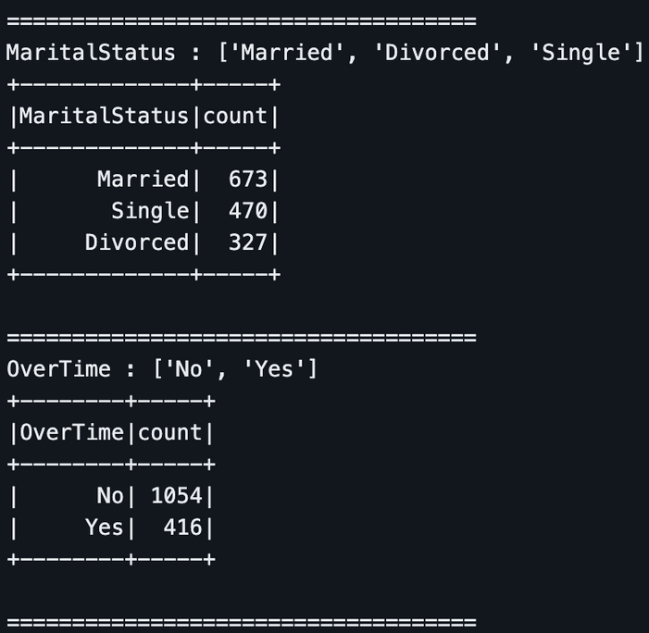
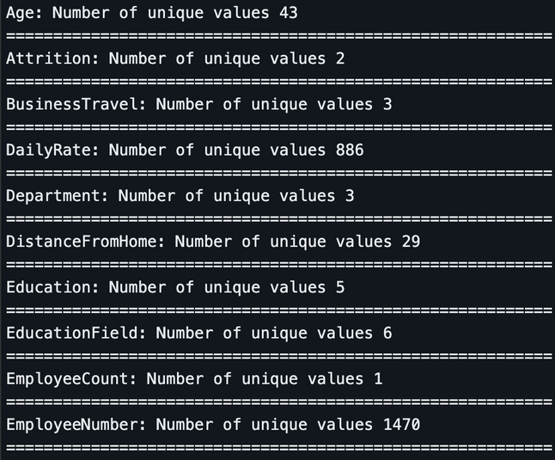
EXPLORATORY DATA ANALYSIS
Supervised learning algorithms are trained on labeled datasets, learning to map inputs to outputs. They are widely used in classification and regression tasks, enabling predictions and decisions based on previous experiences.
01
UNIQUE COUNTS
02
CATEGORICAL COLUMNS
We notice that 'EmployeeCount', 'Over18', 'StandardHours' have only one unique values and 'EmployeeNumber' has 1470 unique values. This features aren't useful for us, So we are going to drop those columns.

Slide 6
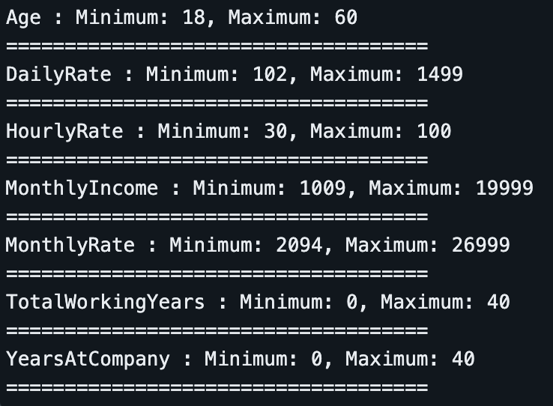
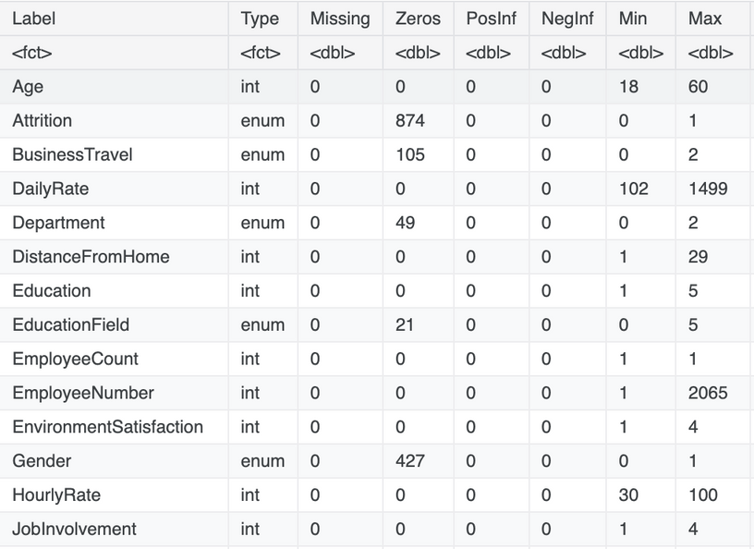
EXPLORATORY DATA ANALYSIS
03
NUMERICAL FEATURES
04
MISSING VALUES

Slide 7
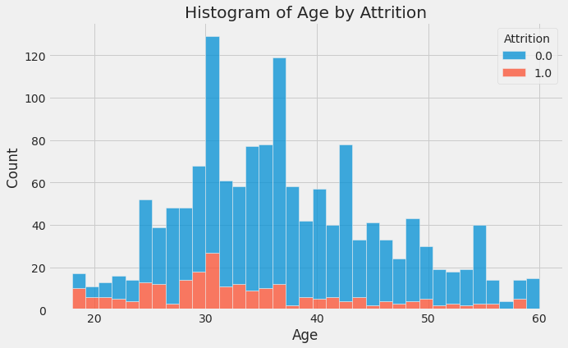
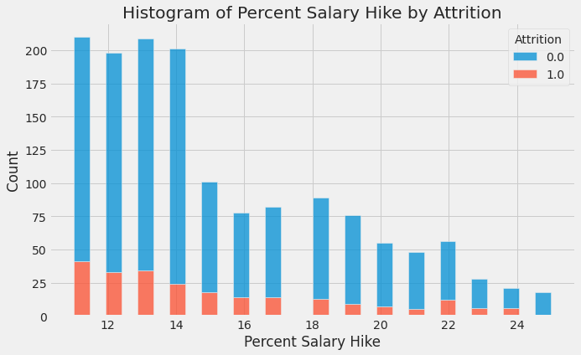
EXPLORATORY DATA ANALYSIS
05
AGE
06
SALARY HIKE

Slide 8
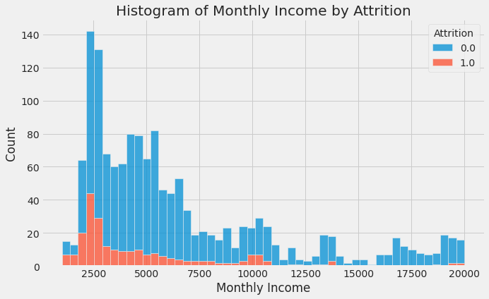
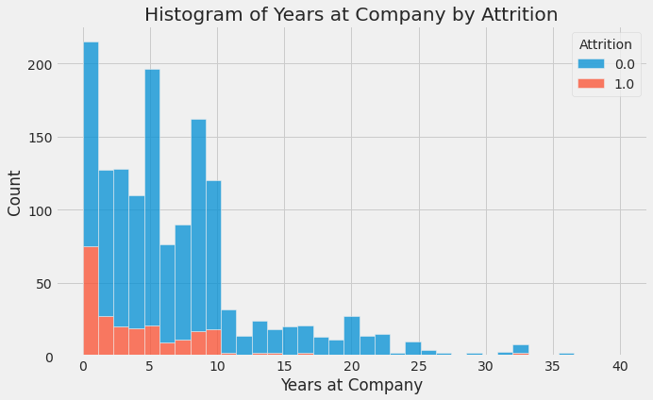
EXPLORATORY DATA ANALYSIS
07
MONTHLY INCOME
08
YEARS AT COMPANY

Slide 9
EDA CONCLUSIONS
The workers with low JobLevel, MonthlyIncome, YearAtCompany, and TotalWorkingYears are more likely to quit there jobs.
BusinessTravel : The workers who travel alot are more likely to quit then other employees.
Department : The worker in Research & Development are more likely to stay then the workers on other departement.
EducationField : The workers with Human Resources and Technical Degree are more likely to quit then employees from other fields of educations.
Gender : The Male are more likely to quit.
JobRole : The workers in Laboratory Technician, Sales Representative, and Human Resources are more likely to quit the workers in other positions.
MaritalStatus : The workers who have Single marital status are more likely to quit the Married, and Divorced.
OverTime : The workers who work more hours are likely to quit then others.

Slide 10
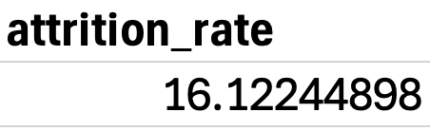
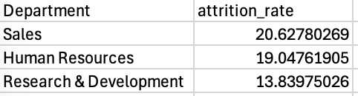
SPARK SQL QUERIES:
We have found some insights by the following Spark SQL queries
01
What is the attrition rate in the organization?
02
WHICH DEPARTMENT HAS THE HIGHEST ATTRITION RATE?
03
WHICH BUSINESS UNIT IS LOSING ITS HIGH PERFORMERS?

Slide 11
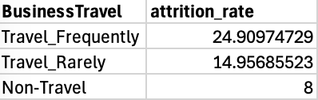
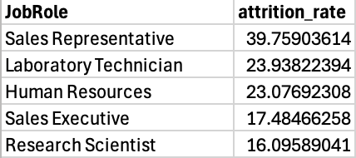
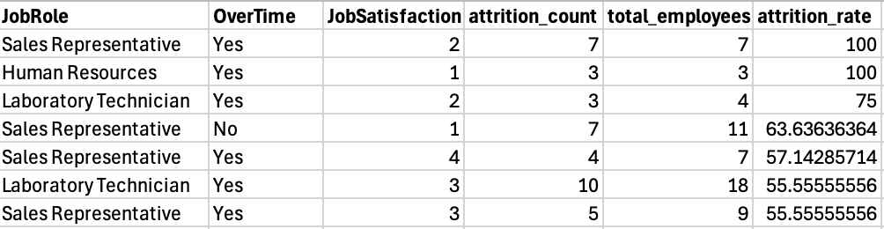
SPARK SQL QUERIES:
04
What is the impact of business travel on attrition?
05
WHAT JOB ROLES HAVE THE HIGHEST ATTRITION?
06
HOW DOES A COMBINATION OF JOB ROLE, OVERTIME, AND JOB SATISFACTION IMPACT ATTRITION?

Slide 12
PREDICTIVE MODELING USING SPARK MLLIB
01
OBJECTIVE
Develop machine learning models to predict employee attrition.
Compare performance of different classification models using Spark MLlib.
02
DATA PREPROCESSING FOR ML
Categorical Encoding: Used StringIndexer & OneHotEncoder to transform categorical features.
Feature Engineering: Used VectorAssembler to create a feature vector for ML models.
Train-Test Split: Split data into 80% training & 20% test set.

Slide 13
PREDICTIVE MODELING USING SPARK MLLIB
03
MODELS TRAINED
We implemented four classification models to predict attrition:
Logistic Regression – Baseline model for benchmarking.
Random Forest – Strong tree-based model for structured data.
XGBoost – Advanced boosting algorithm, highly effective for tabular data.
CatBoost – Best suited for datasets with categorical-heavy features.
Pipeline Approach: Automated feature transformations & model training.

Slide 14
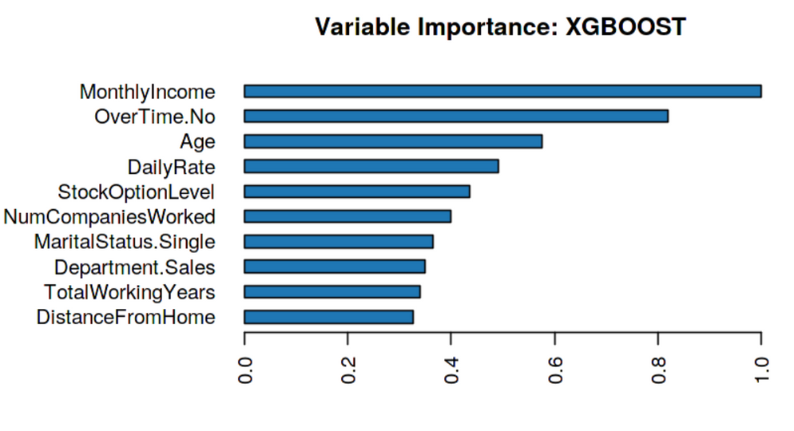
PREDICTIVE MODELING USING SPARK MLLIB
04
FEATURE IMPORTANCE
Top Reasons why Employees leave the Organization:
No Overtime
Monthly Income
Age

Slide 15
PREDICTIVE MODELING USING SPARK MLLIB
05
MODEL PERFORMANCE COMPARISON
Metrics Evaluated:
Accuracy → Measures overall correctness.
F1-Score → Harmonic mean of precision and recall, useful for imbalanced datasets.
AUC (Area Under ROC Curve) → Assesses model discrimination power.
Precision-Recall Score → Evaluates model’s effectiveness for imbalanced data.
MODEL | ACCURACY | F1- SCORE | AUC (ROC) | Precision-Recall
Logistic Regression | 86.22% | 0.8581 | 0.8114 | 0.5492
Random Forest | 85.43% | 0.8036 | 0.7929 | 0.5081
XGBoost | 87.01% | 0.3187 | 0.8003 | 0.5155
CatBoost | 88.98% | 0.3764 | 0.8227 | 0.6330

Slide 16
PREDICTIVE MODELING USING SPARK MLLIB
FINAL TAKEAWAYS
Best Accuracy: CatBoost (88.98%) performed best in overall accuracy, indicating strong predictive power.
Highest AUC (ROC): CatBoost (0.8227) showed the best ability to differentiate between employees staying and leaving.
Best Precision-Recall AUC: CatBoost (0.6330) is the most effective at detecting employees likely to leave, making it the best model for HR to take action on high-risk employees.
F1-Score Analysis: Logistic Regression (0.8581) had the highest F1-score, showing better balance between precision & recall, but lacks interpretability compared to tree-based models.
Random Forest & XGBoost: Decent performance, but not as strong as CatBoost, likely due to categorical-heavy dataset where CatBoost excels.

Slide 17

CONCLUSION AND INFERENCES:
01
AGE
People are tending to switch to a different jobs at the start of their careers, or at the earlier parts of it. Once they have settled with a family or have found stability in their jobs, they tend to stay long in the same organization- only going for vertical movements in the same organization.
02
INCENTIVES
Salary and stock options have a great motivation on the employees and people tend to leave the organization much lesser. Higher pay and more stock options have seen more employees remain loyal to their company.
03
WORK-LIFE BALANCE
Work life balance is a great motivation factor for the employees. However, people with a good work-life balance, tend to switch in search of better opportunities and a better standard of living.
04
WORK STRESS
Departments where target meeting performance is very much crucial (for e.g. Sales) tend to have a greater chances of leaving the organization as compared to departments with more administration perspective (For e.g. Human Resources)

